Slide 1
PRACTICE TRACKER POC
By : Himaja Pendyala

Slide 2
.
POC: Problem Statement and Solution
Problem Statement
Develop a Python script to fetch employee data from the Database and automatically sync it with a SharePoint list used by PowerApps. The script should run daily to ensure that new records are inserted, updates are applied, and inactive employees are removed.
Solution
We use database credentials to connect to the database through a Python script and fetch employee data.
Authentication with SharePoint is implemented using the client ID, client secret, and tenant ID.
The script integrates with the Microsoft Graph API to perform insert, update, and delete operations on the SharePoint list.

Slide 3
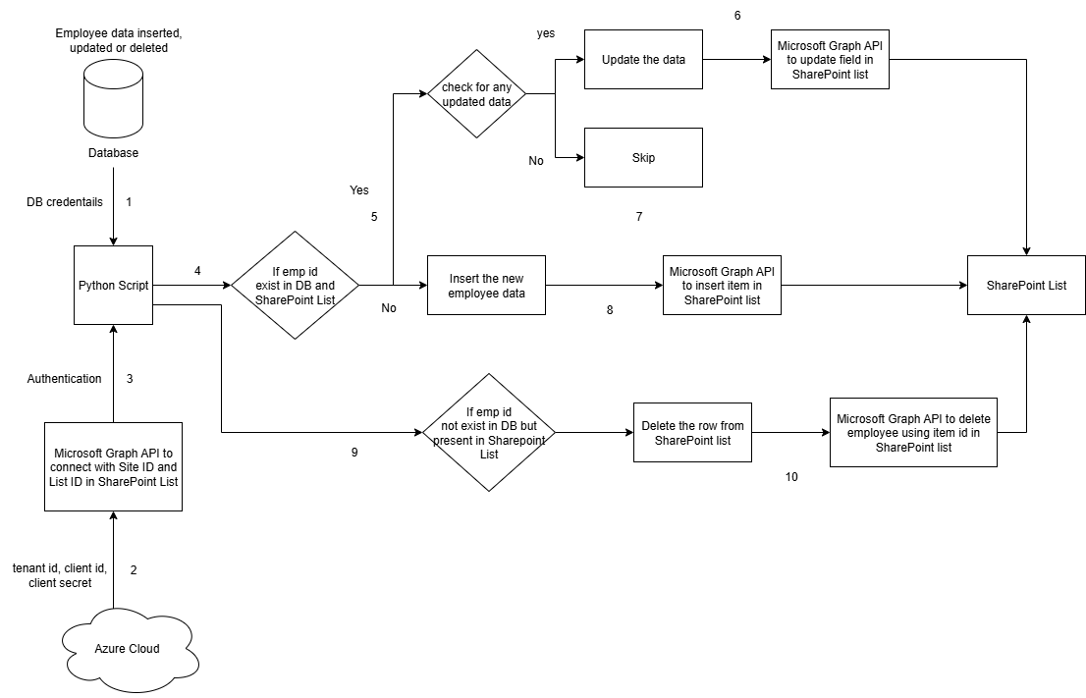
Workflow Diagram
Database Credentials to connect with Python script
Azure App Registration – tenant id, client id and client secret
Authenticate Microsoft Graph API to connect SharePoint with Python script
Data Synchronization (Insert / Update / Delete)

Slide 4
Architecture Explanation
1. Database Connection
The Python script connects to the Database using database credentials (host, user, password, database).
It fetches the employee data.
2. Azure App Registration
An Azure App is registered to obtain the Client ID, Client Secret, and Tenant ID.
These credentials allow secure authentication with Microsoft Graph API.
3. Microsoft Graph API Authentication
The Python script uses the Azure credentials to authenticate with Microsoft Graph API (OAuth 2.0).
Once authenticated, the script can interact with SharePoint Online.
4. Data Synchronization (Insert / Update / Delete)
The Python script performs CRUD operations (Insert, Update, Delete) on the SharePoint List to keep employee data up to date.

Slide 5
Key Points
1. Azure App Registration: Ensure proper API permissions are granted for Microsoft Graph API and SharePoint:
Microsoft Graph API: Sites.ReadWrite.All, Sites.Selected
SharePoint: Sites.FullControl.All, Sites.ReadWrite.All, Sites.Selected
2. Database Access: Administrator access is required for establishing the database connection.
3. SharePoint List Configuration: The column headers in the SharePoint list must exactly match the database table column names to avoid mapping issues.
4. Importing Excel sheets as SharePoint lists should be avoided. SharePoint automatically assigns different internal names to columns (e.g., field_1, LinkTitle). Additionally, column headers containing special characters lead to altered internal names (e.g., Display Name: Employee Code → Internal Name: Employee_x0020_Code).
5. The default Title column in SharePoint should not be deleted. It can be renamed to align with the corresponding database field name.
6. SharePoint Data Types: Number fields automatically convert 1 → 1.0.
DateTime fields must use the ISO 8601 UTC format 2025-08-06 15:59:45 → 2025-08-06T22:59:45Z.
To prevent unwanted updates caused by datatype conversions, use Single line of text for such fields to store values exactly as received.
7. Microsoft Graph API Pagination: The Microsoft Graph API retrieves data in batches typically 20 batches per run, with 10 rows per batch (i.e., 200 rows per request cycle). To handle lists with more than 200 records, the @odata.nextLink property should be used to fetch subsequent batches until all data is retrieved.

